Slide 1
Farm Connect
Revolutionary marketplace for connecting farmers !!

Slide 2
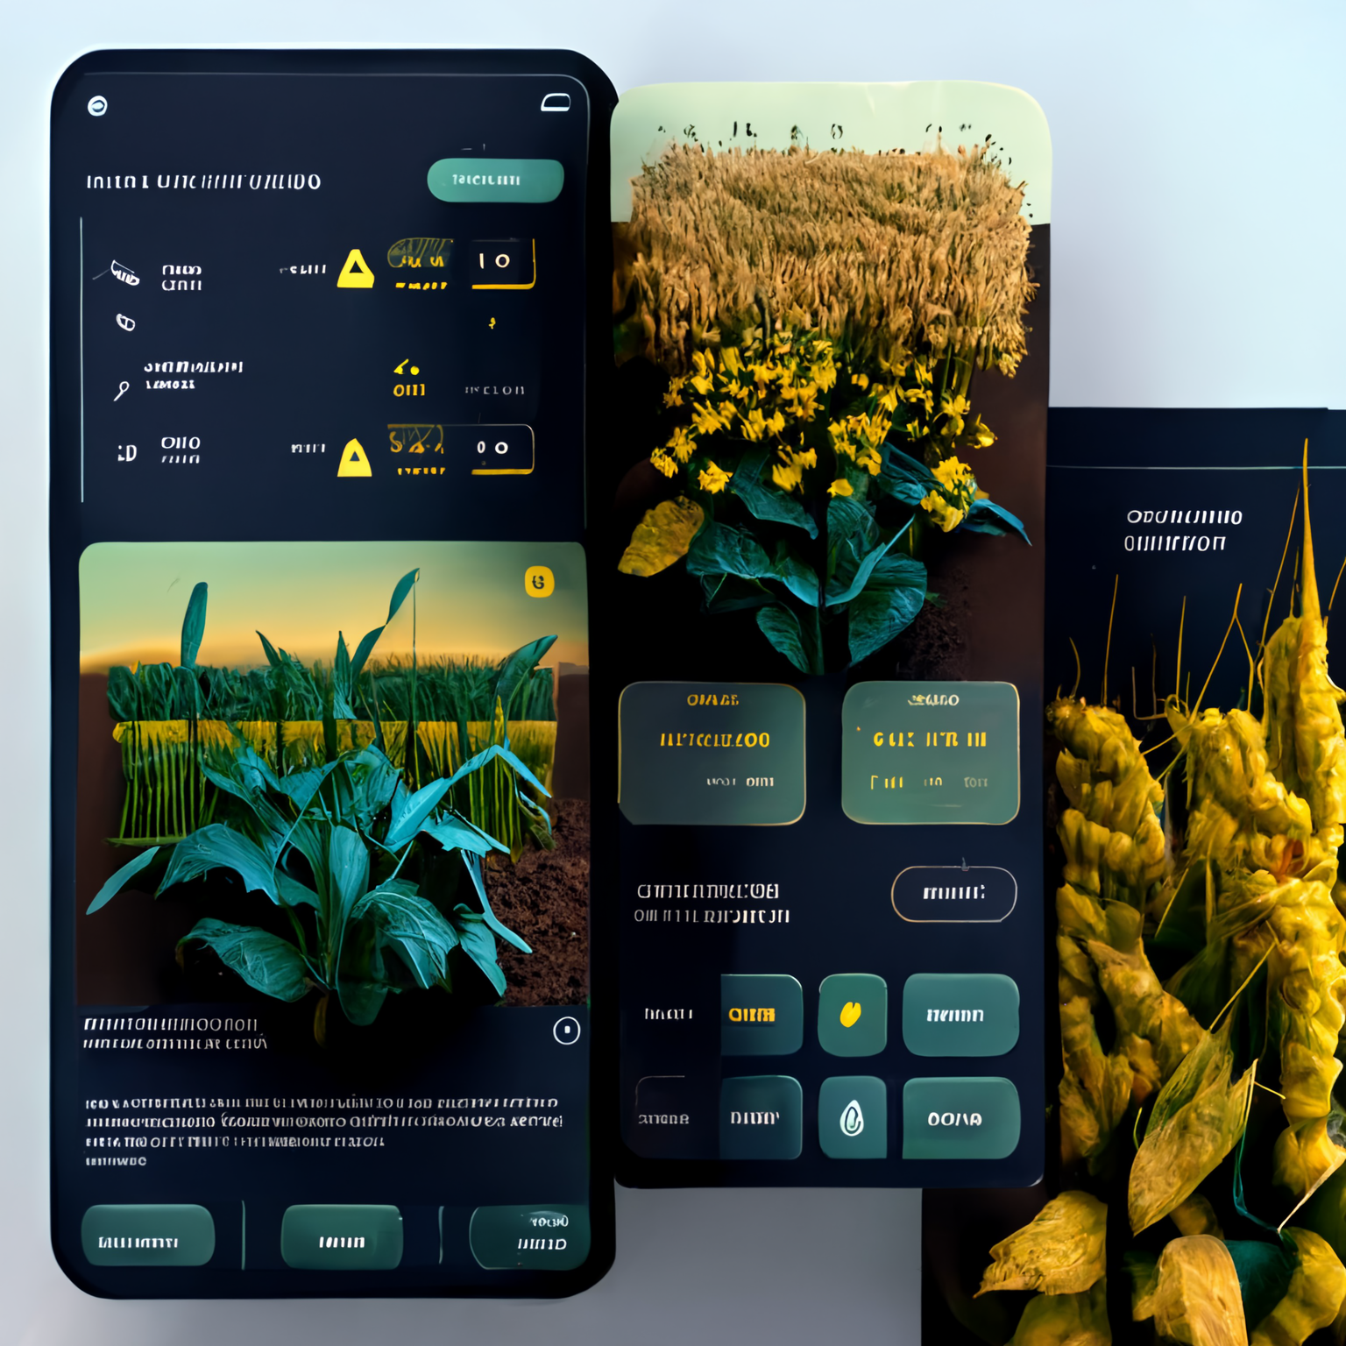
SOLUTION
PROBLEM STATEMENT
Connecting farmers to resell their unused pesticides, fertilizers, and agricultural equipment, the proposed solution could be to develop a application-based platform to create profiles and list unused items as well as new products for sale.
Farmers often have leftover pesticides, seeds , fertilizers, and Agricultural equipment that they do not use, which can be wasteful and costly. At the same time, other farmers may need access to these products but cannot afford to buy them at market prices.
Adding to it , they don’t know which is the best place to buy fertilizers at the best price and which is nearer to them.

Slide 3
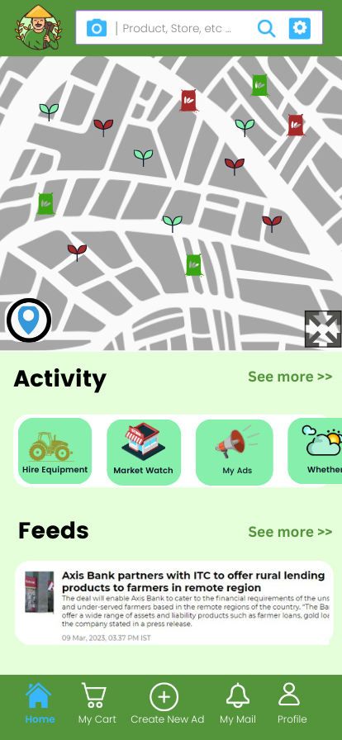


SOLUTION SCOPE
Characteristics
Our mobile app facilitates the buying and selling of fertilizers, pesticides, seeds, and other agricultural inputs.
It serves as a marketplace for farmers to resell their unused products as well as retailers to farmers
NEW SEEDS
Features
OLD SEEDS
The platform could include features such as
Precision agriculture
Messaging functionality
Environmental monitoring
Disaster response
Building a community for farmers

Slide 4

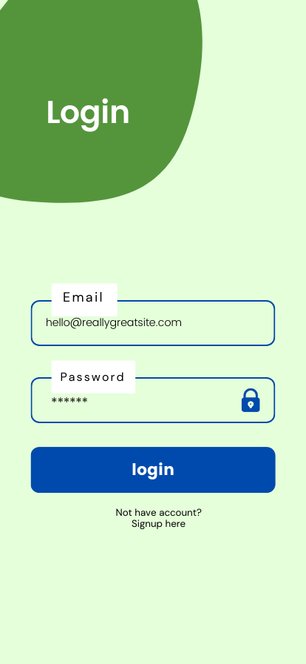
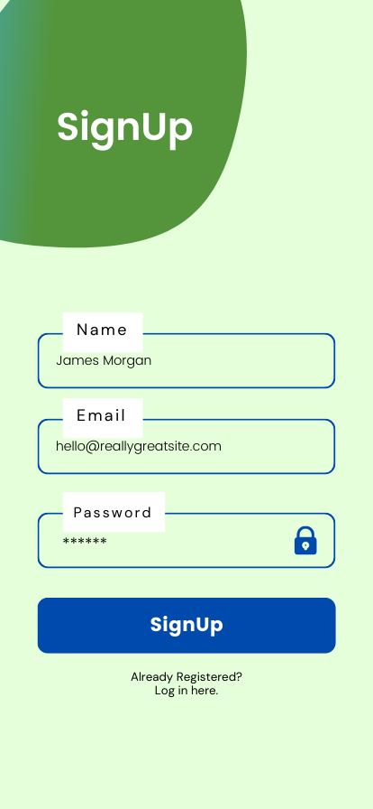

Slide 5

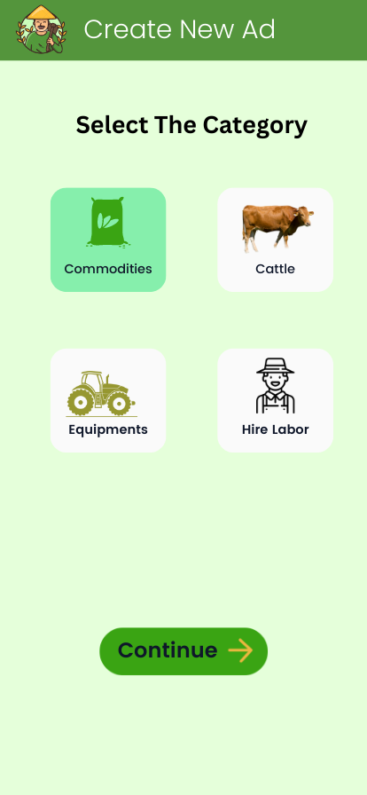
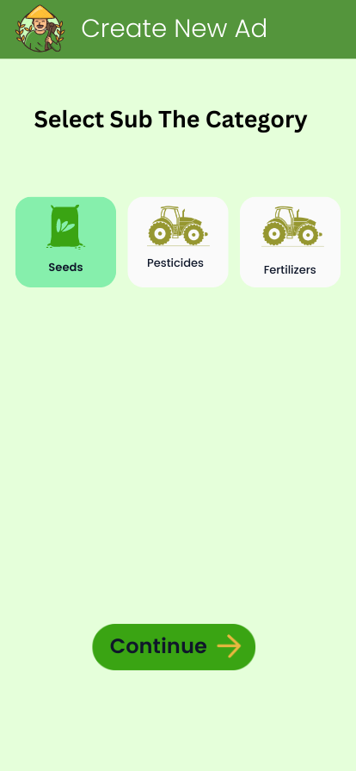
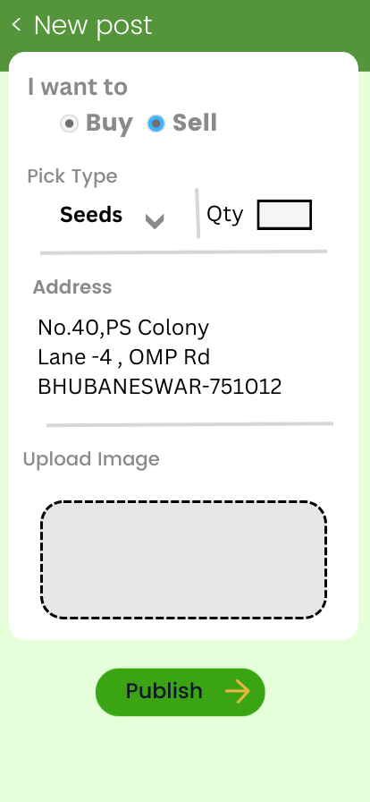

Slide 6

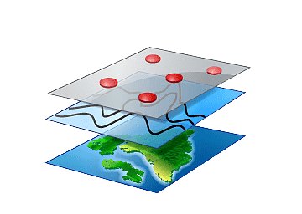


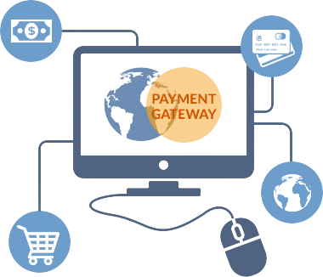
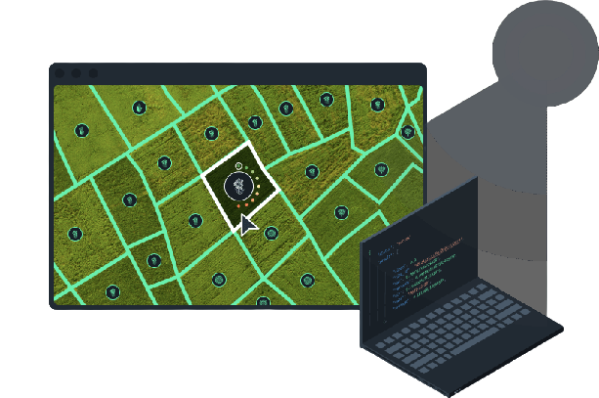






Technology Stack
FRONT-END DEV
BACK-END DEV
CLOUD PLATFORMS
GEOSPATIAL TOOLS
APIs INTEGRATING
Payment gateway integration

Slide 7
Impact
No improper Disposal of unused pesticides and seeds that can hamper the environment and lead to climate change
The application gives information of climate change , emergency disaster alerts, good user interface, nice user experience
The users will get the alerts and the information direct on the notification calls.
The system focuses on improving the rate of productivity of the farming and aims to assist the farmers in need.
The personal phone notifications and alerts are a strong supporting tool in improving profitable farming strategies.

Slide 8
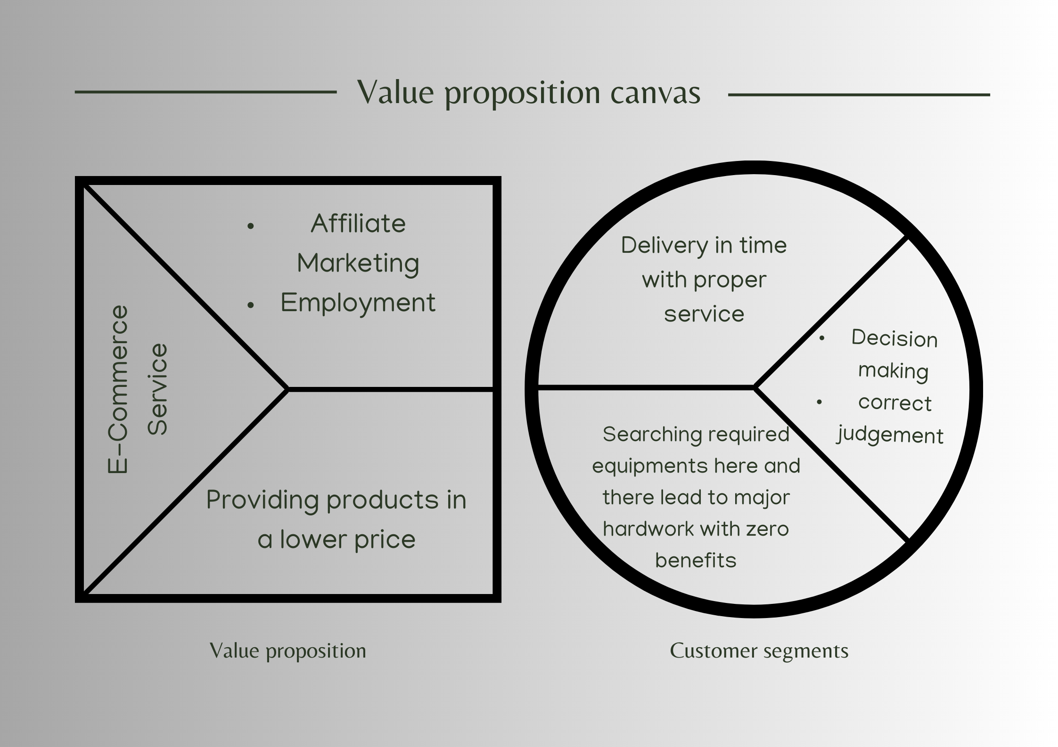
Business Model
E-commerce Integration: Collaborate with agricultural input suppliers or equipment manufacturers to establish an e-commerce section within the platform.
Commission Model: Take a commission on every transaction made through the app, such as the sale of crops, livestock, or farm equipment.

Slide 9
Thank You

